Slide 1
ADULT FORUM UPDATE
SEPTEMBER 16, 2012
EPISCOPAL SPIRITUAL LIFE RENEWAL

Slide 2
PROCESS UPDATE
Survey Taken – January and February
Workshops Done – April and May
Initiatives Drafted – June and July
Initiatives Approved – August
Roll Out of Initiatives – September and Beyond

Slide 3
Workshop Topics
Understanding FOLLOW ME
Understanding Our Data
Identifying Actions
Taking Action

Slide 4
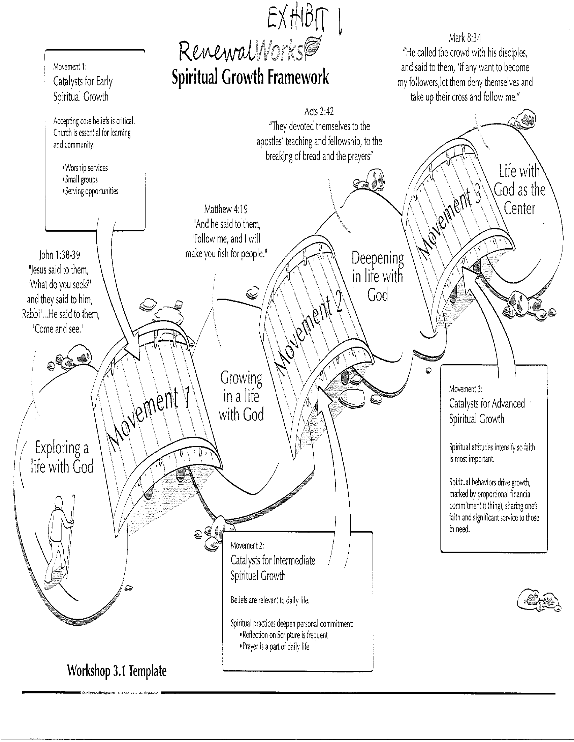

Slide 5
SL DEMOGRAPHICS
Segment SL Ranking
Exploring a Life with God 22% Upper 25%
Growing in a Life with God 54% Upper 25%
Deepening in Life with God 19% Lower 25%
Life with God as the Center 5% Lowest 10%

Slide 6
WORKSHOP INITIATIVES
Embedding Scripture and Prayer in Everything We Do
Promote/Teach Personal Spiritual Practices
Small Groups for Spiritual Growth

Slide 7
Embedding Scripture and Prayer
In Everything We Do
Deuteronomy 11 18-21
18 “You shall therefore lay up these words of mine in your heart and in your soul, and you shall bind them as a sign on your hand, and they shall be as frontlets between your eyes.19 You shall teach them to your children, talking of them when you are sitting in your house, and when you are walking by the way, and when you lie down, and when you rise. 20 You shall write them on the doorposts of your house and on your gates, 21 that your days and the days of your children may be multiplied in the land that the Lord swore to your fathers to give them, as long as the heavens are above the earth.

Slide 8
Embedding Scripture and Prayer
In Everything We Do
What is this Initiative?
Why was It Selected?
How Will it be Introduced to the Parish?

Slide 9
Spiritual Practices Background
Background
Adult Formation was highlighted as a priority in the parish survey and vestry planning in 2010.
The team has completed “The Story” and “Who is Jesus” series past two calendar years.
The recent Episcopal Spiritual Life Renewal (ESLR) survey completed in early 2012 highlighted Spiritual Practices as key to individual spiritual growth.
Spiritual Practices include a broad array of practices such as prayer, meditation, Lectio Divina, and reflection on scripture.
2012 / 2013 Adult Formation Plan
The Adult formation team will initiate a program of short, 3-4 week explorations of the different spiritual practices.
The goals of the Spiritual Practices program are to:
Provide the parish with an overall introduction to spiritual practices
Develop in depth and an ongoing exploration of different spiritual practices

Slide 10
Spiritual Practices Rollout Schedule (Draft)
Each week, we will explore 1) explore the background of key practices, 2) provide practical tools, and 3) and experience it as a group. The regular meeting time will be Sundays following the service with special programs considered for Wednesday nights.
Draft Formation Plan
Sept. 16 Welcome to the Episcopal Church
Sept. 23 – Sept. 30 (2 weeks) What are the Spiritual Practices?
Oct. 7 Columbus Day / No Formation
Oct. 14 – Oct. 28 (3 weeks) Spiritual Practice of Prayer
Nov. 4 – Nov. 18 (3 weeks) Lectio Divina
Nov. 25 Thanksgiving / No Formation
Dec. 2 – Dec. 16 (3 weeks) Journaling
Dec. 23 Kids Pageant / No Formation
Jan. 6 – Jan. 20 (3 weeks): Personal Creativity (Prayer in color)
Jan. 27 Annual Meeting / No Formation
Feb. 3 - Feb. 10 (2 weeks): Spirituality in Popular Culture

Slide 11
Small Groups Initiative
Why small groups?
  Our survey results showed that in 4 main categories of satisfaction at St. Lawrence, developing spiritual relationships had the least amount of satisfaction.
  St. Lawrence already does worship, formation and coffee hour well. We now have an opportunity to initiate small groups both on Sunday mornings and at other times during the week that will help our congregation to build spiritual relationships that feed spiritual growth.

Slide 12
Small Groups Action Plan
Make time for small group interaction on Sunday mornings, when people are at church. Small Group Sundays could take the place of coffee hour and Adult Formation. A topic can be introduced to the whole group, then a conversation held at each small group table.
Make parishioners aware of the small group opportunities that already exist.
Encourage the formation of small groups that meet outside of Sunday morning worship times. These groups can be organized by interest, stage in life or even meeting availability.
Six members is an ideal number for a small group meeting outside of Sunday morning worship times. Confidentiality and trust are important to the small group process; at the same time, clergy guidance is always available to help with group dynamics.
Small group Sundays would include our youth, grades 9 and older.

Slide 13
QUESTIONS AND ANSWERS

